Slide 1

AirTable for Version Tracking of Revit Details
June 16, 2022
Sean McDonald, Corporate BIM Manager
Dr. Kristopher Dane, Director of Digital Design
Digital Built Week Americas
Anaheim, California

Slide 2
outline
Introduction
Digital Design at Thornton Tomasetti
Speakers
Problem
Solution
Revit Model
Airtable
Rest API
Dynamo
Conclusion
Q/A

Slide 3


introduction
Digital Design (D2) at Thornton Tomasetti
Design Practices
Information Technology
Structural Engineering
Construction Engineering
Protective Design
Forensics
Renewal
Digital Design
Why? So project teams can do work that is worth their time; to focus on high value, high impact problems rather than the commodity activities.

Slide 4


introduction
Presenters
Dr. Kristopher Dane
Director of Digital Design
Seattle, WA
Sean McDonald
Corporate BIM Manager
Chicago, IL

Slide 5
The Problem

Slide 6
The problem
Standards are important but they change
Standard / Typical Details
Important for efficiency and risk management
Captures (some of) the institutional knowledge of the firm
But…they change!
On a different timeline than projects
How do I make sure designers are using the current details?
(Oh, and…checking manually stinks)

Slide 7
The Solution

Slide 8
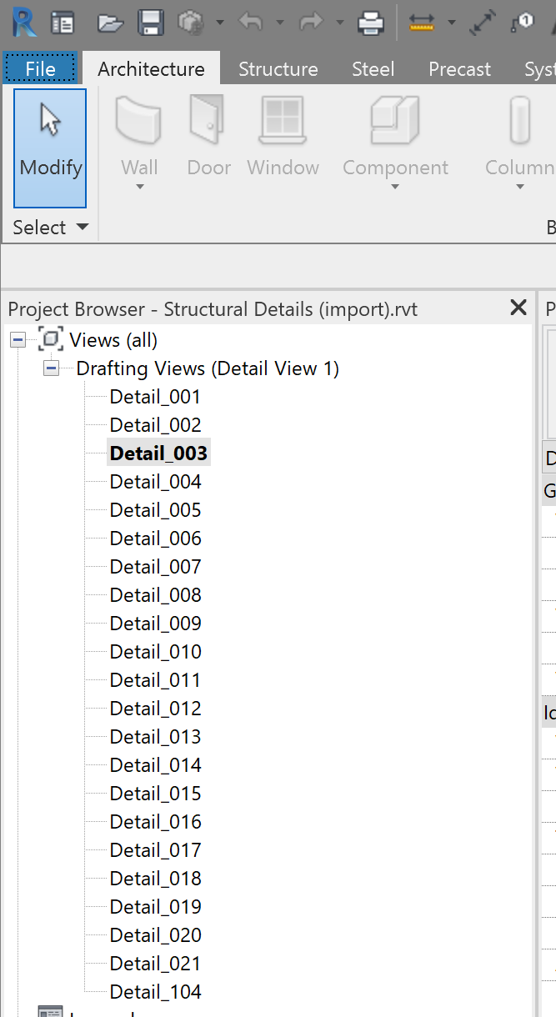
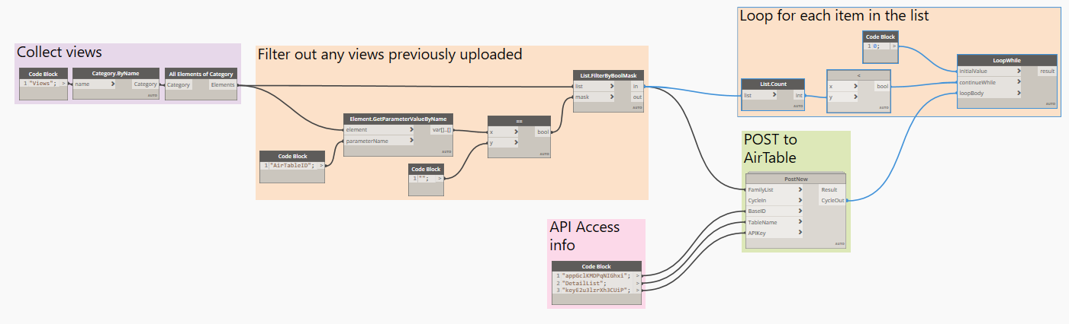
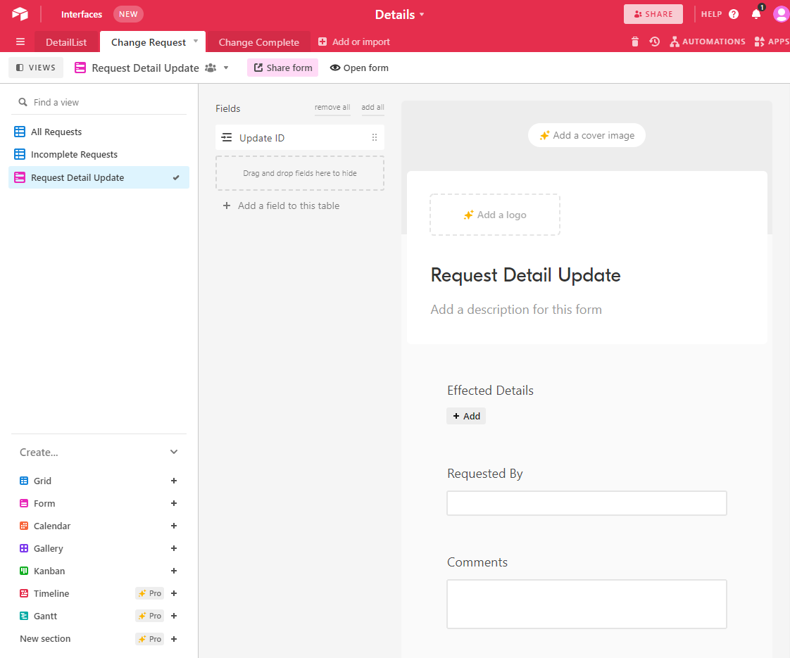
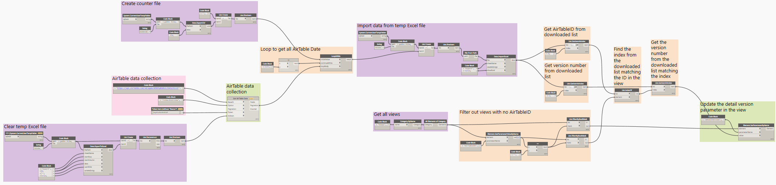
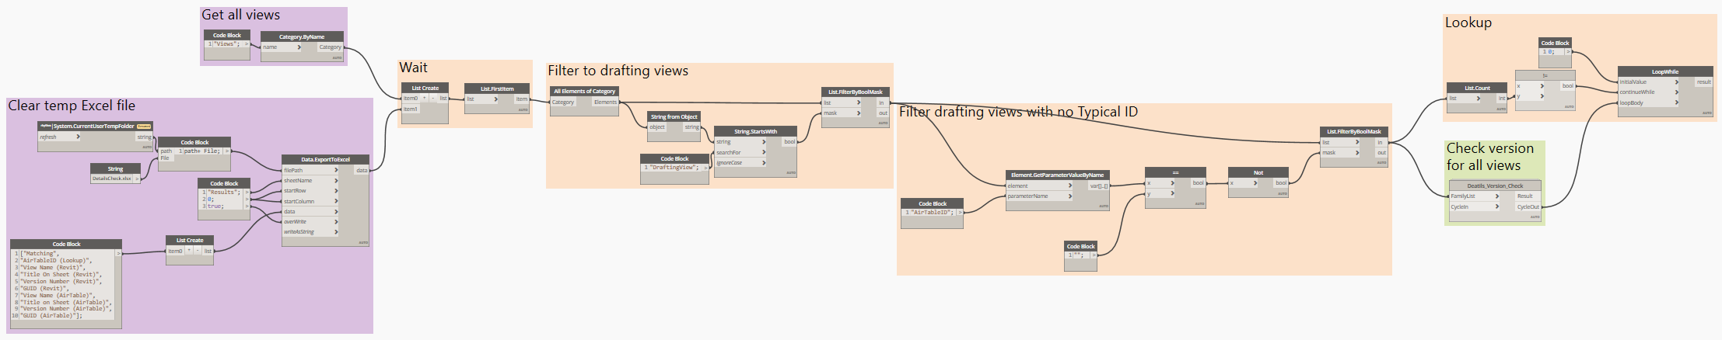
solution
We’re providing all of this to you via GitHub!
Flexible and Accessible
Revit
Dynamo
REST API
Airtable

Slide 9
The Revit MODEL

Slide 10
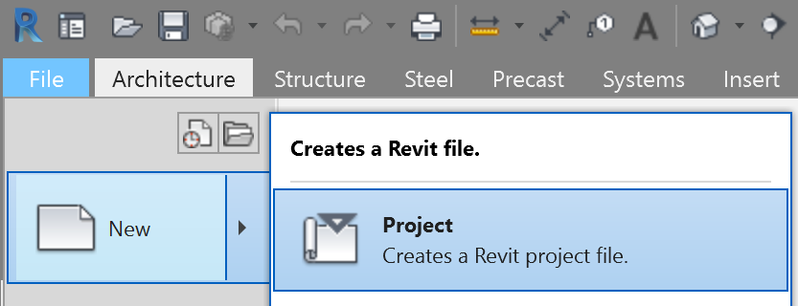
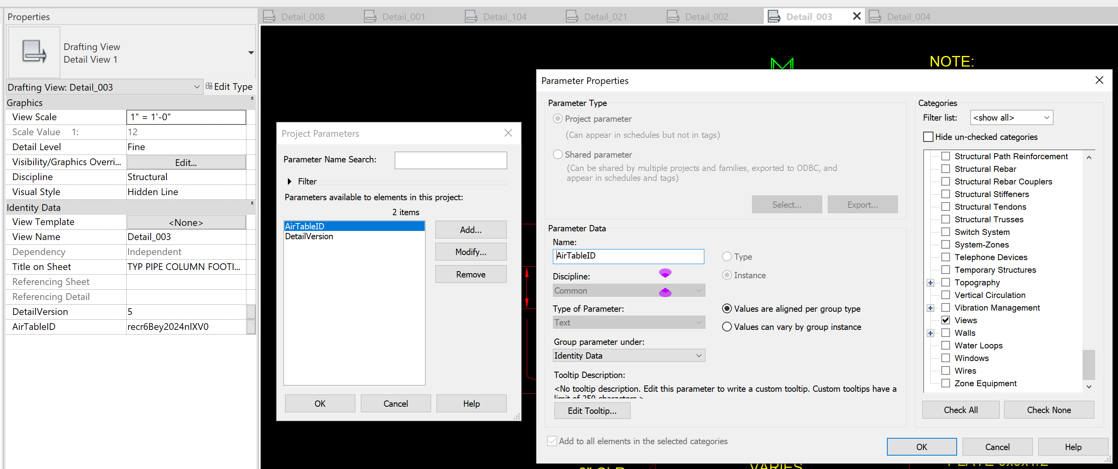
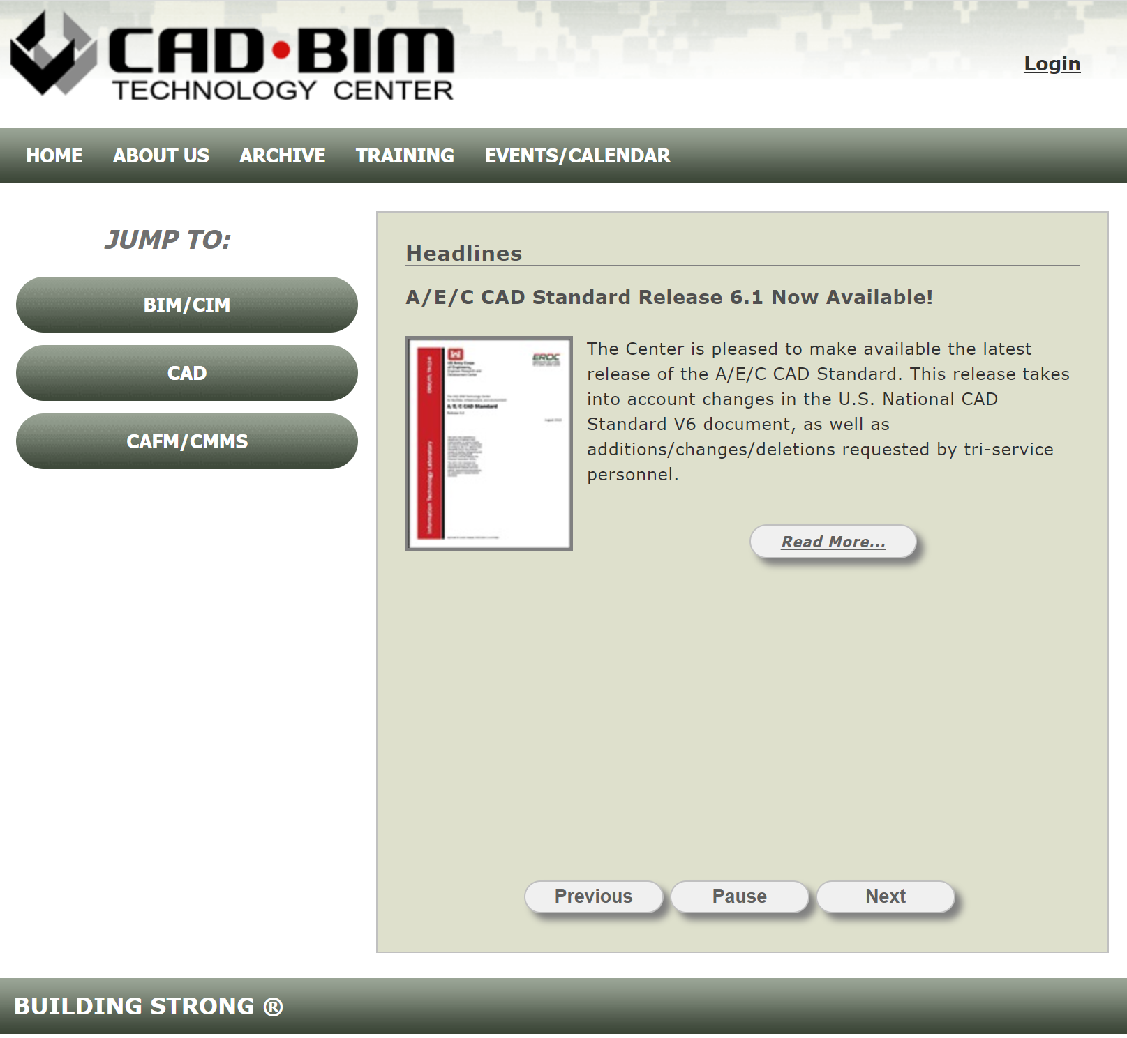
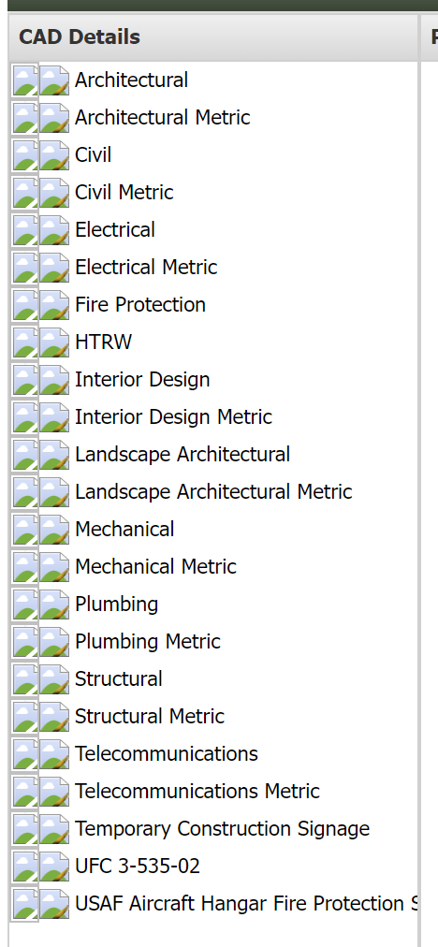
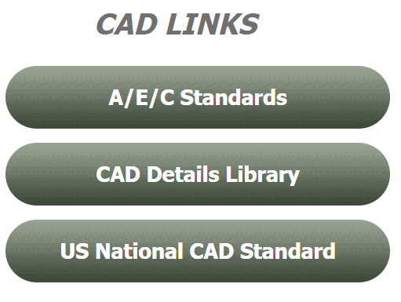
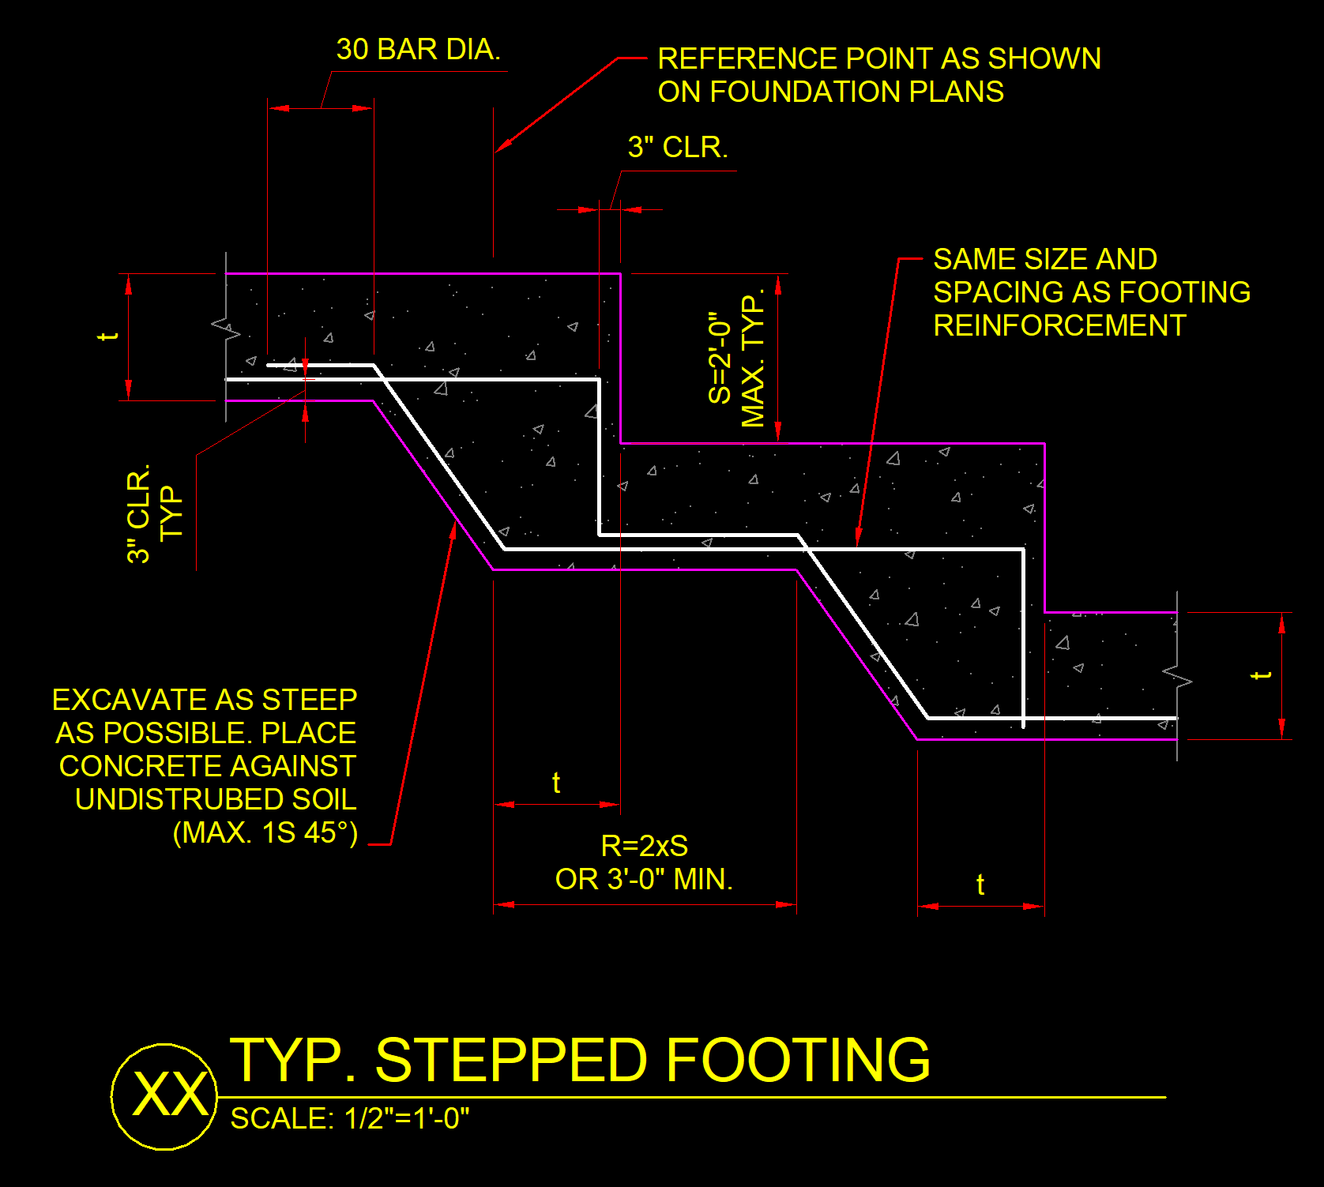
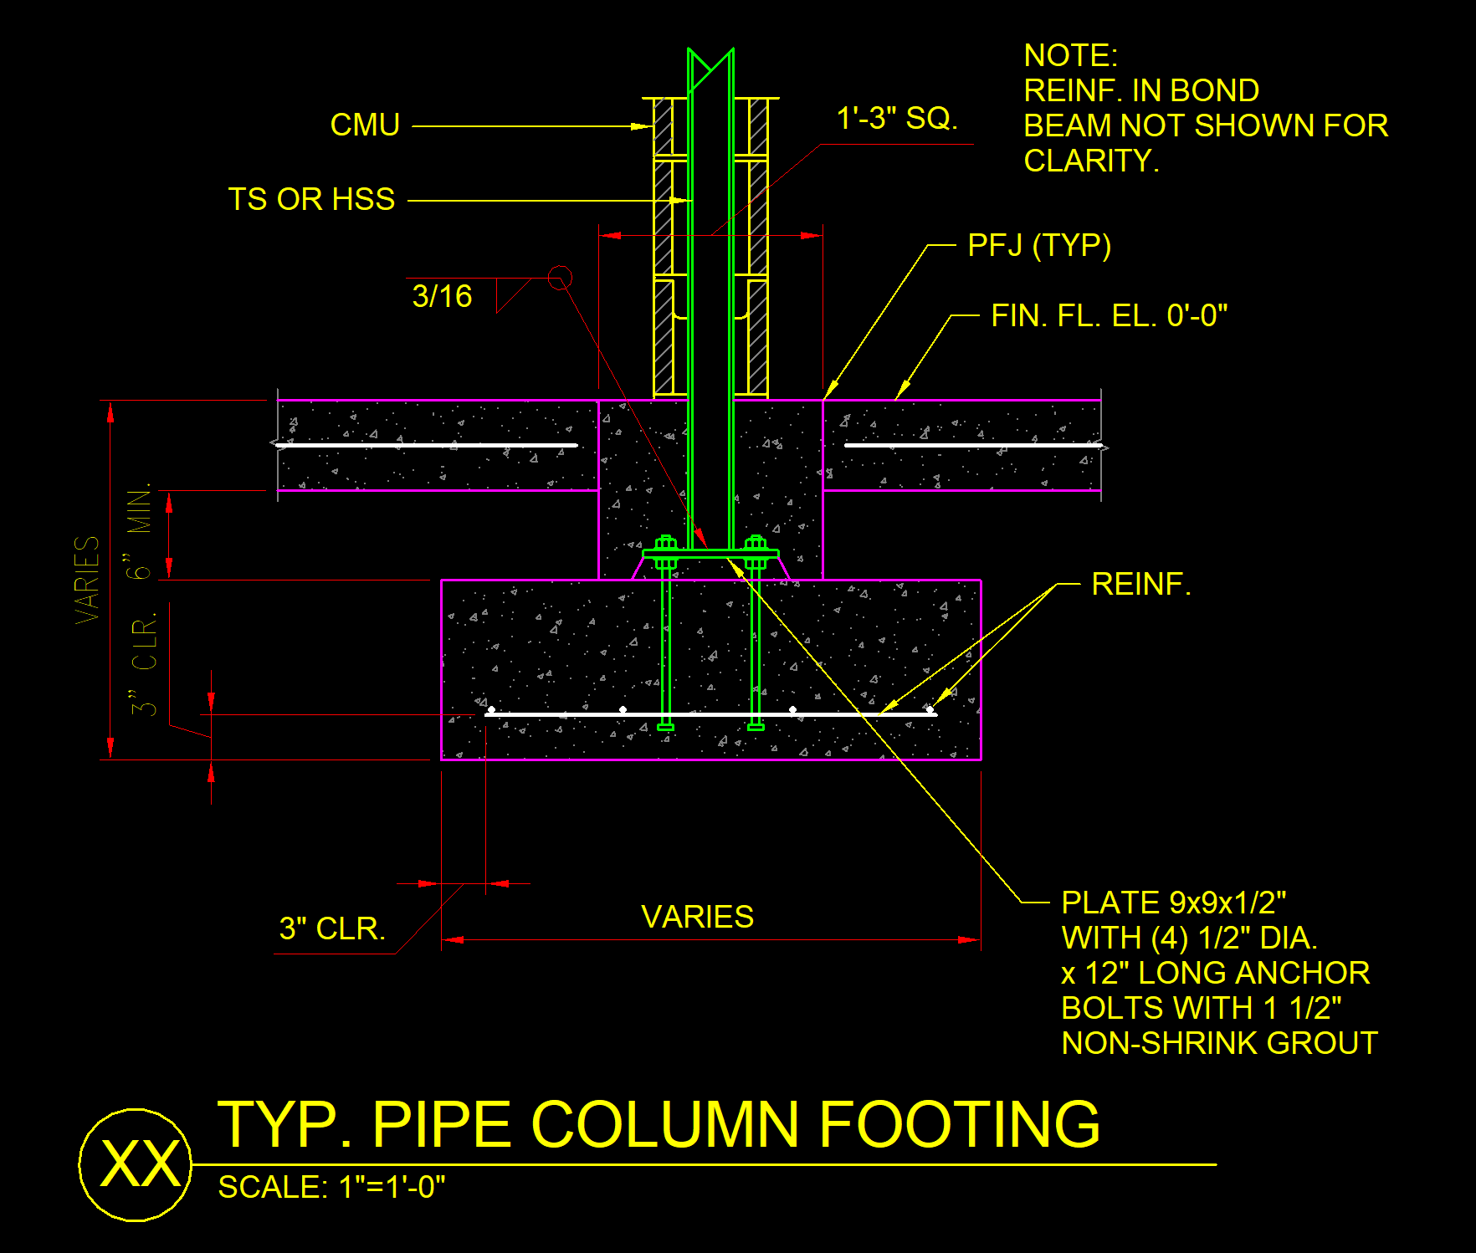
The model

Slide 11
AirTable

Slide 12

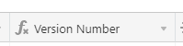
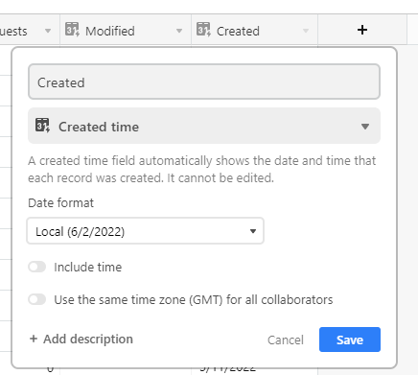
Setting up AirTable
https://airtable.com/ Free signup
Add a base
Add columns for what is to be tracked
View Name, Title on Sheet, GUID, etc… Text fields
Version Number Will be calculated
Modified, Created Built in fields

Slide 13
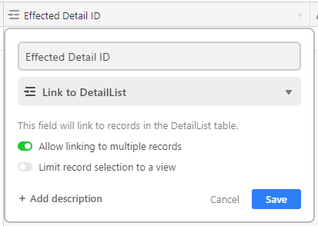
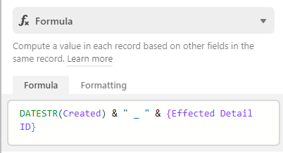
Adding the Process to Airtable
Add table for change requests
Effected Detail ID field is a link to the details list
ChangeID can be calculated

Slide 14
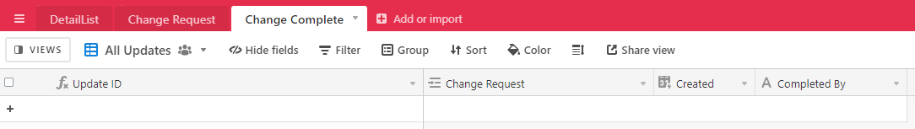
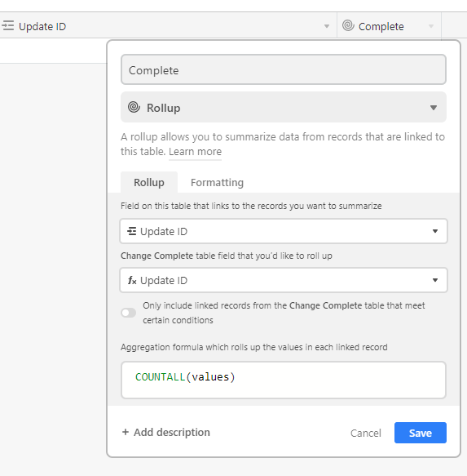
Adding the Process to Airtable
Add table for tracking completion of updates
Change request is link to change request
Update ID link gets added to change request table
Rollup counting Update ID to track complete Gives a 0 if not complete and 1 if complete

Slide 15
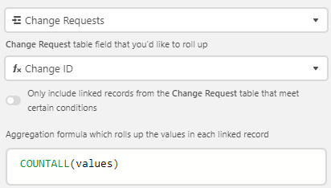
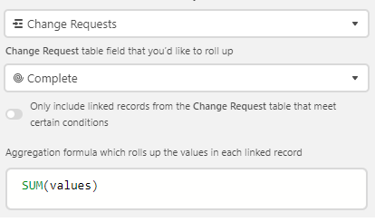
Adding the Process to Airtable
In the Details list table
Change Requests is added
Number of Requests is a count of requests Count of Change ID from request table
Complete Requests is a sum of values from complete rollup in request table. A total of all complete requests to a detail
Incomplete requests is Number of Requests – Complete Requests
Version number is Complete Requests + 1 So we start at version 1 instead of 9

Slide 16
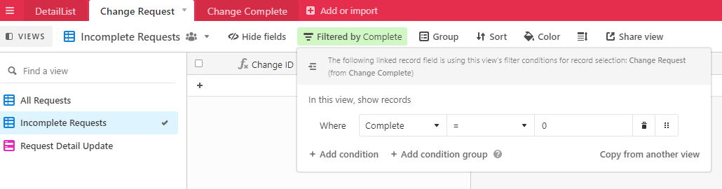
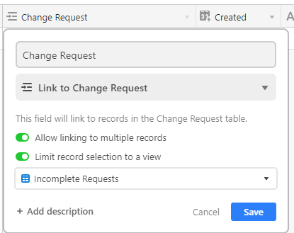
Adding the Process to Airtable
In change request
Add a new view for incomplete requests Filter by complete = 0
In change complete
Limit the change request field to the incomplete requests view

Slide 17
Adding the Process to Airtable
Add and share Forms for both the Request and Complete tables

Slide 18
REST API

Slide 19
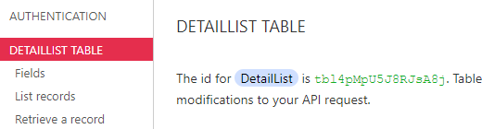
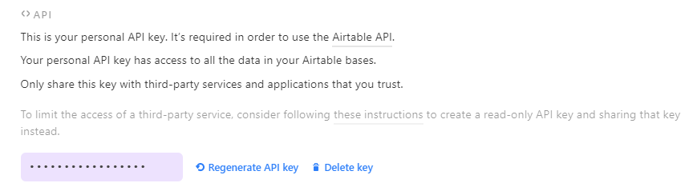
Accessing AirTable API
https://airtable.com/api
Get table ID
https://airtable.com/account
Get API Key

Slide 20
The dynamo Script

Slide 21
Three Parts
We’re providing all of this to you via GitHub!
Taking it step by step
Script 1: Grab from Revit
Get all details
Send to AirTable
Step 2: Grab from Airtable
Get versions from AirTable
Put in detail views
Step 3: Check
Check versions in a file vs AirTable

Slide 22
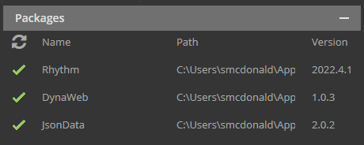
Requirements
Dynamo Packages
DynaWeb (https://radumg.github.io/DynaWeb/)
JsonData
Rhythm
Revit Version 2022
Revit file with custom view parameters
DetailVersion
AirTableID

Slide 23
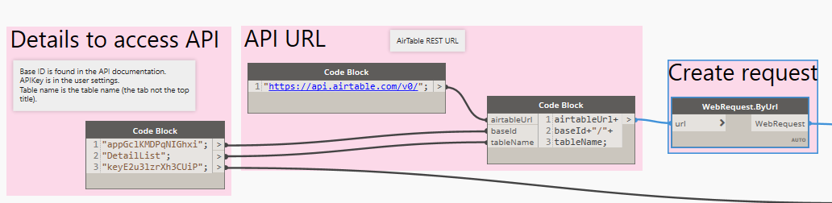
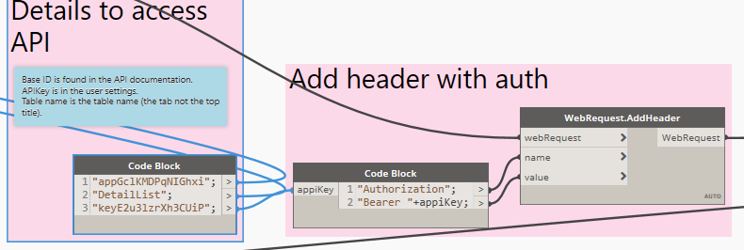
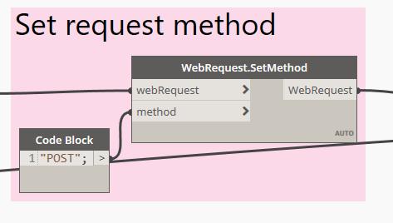
Adding A View to AirTable
Header:
Request URL Airtable API address : https://api.airtable.com/v0/ Base ID : get from your https://airtable.com/api Table Name : plain text name of the table
Authorization By bearer key : from https://airtable.com/account
Method Post

Slide 24
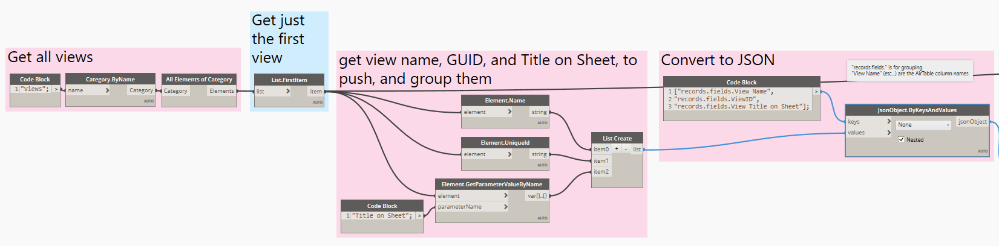
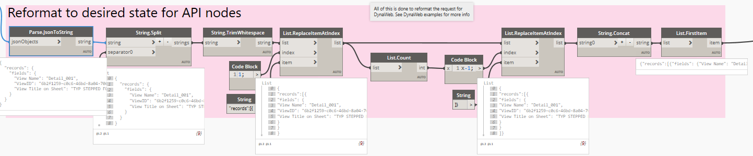
Adding A View to AirTable
Body:
Collect elements and convert to JSON
Reformat for DynaWeb

Slide 25
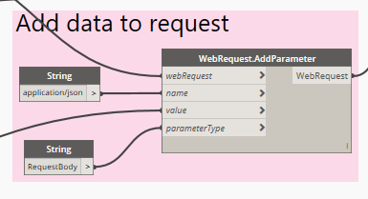
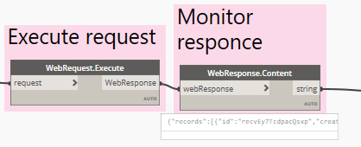
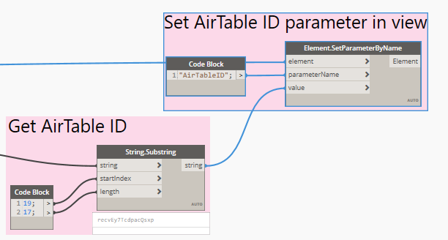
Adding A View to AirTable
Generate Request and execute:
Create request: Header + Body Type + Body + Parameter
Execute and monitor response
Grab ID and pass to Revit View

Slide 26
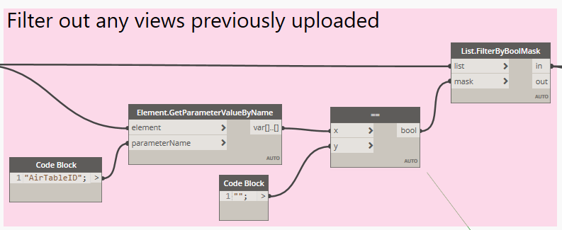
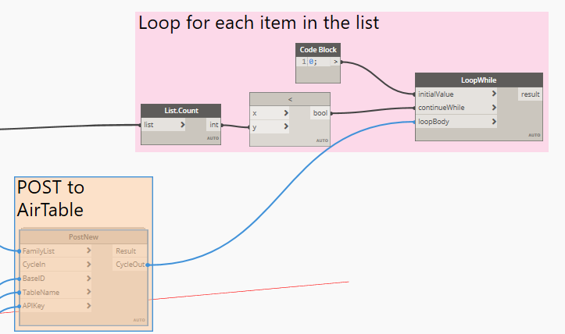
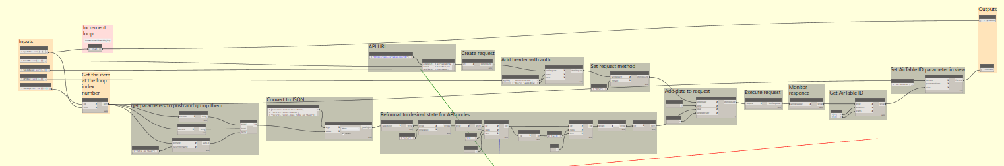
Adding All Views to AirTable
Loop
Filter out previously added views
Loop the request for each view
Grab current loop number for index Increment loop number
Reminder of node the same

Slide 27
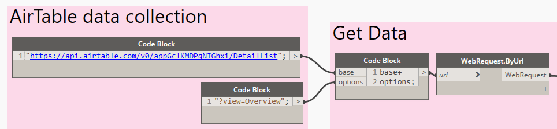
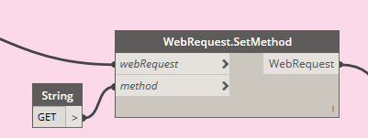
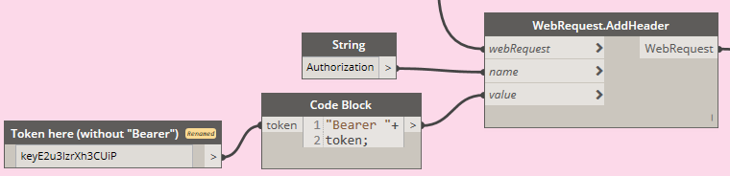
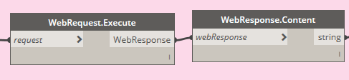
Download Data from Airtable
Header
Build URL
Method Get
Authorization (same as previous)
Execute request

Slide 28
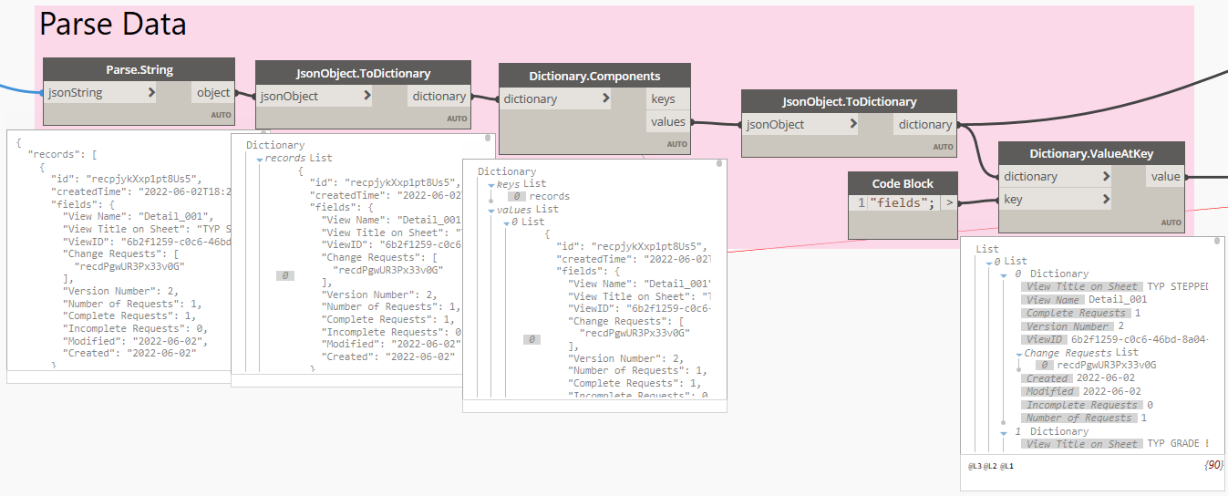
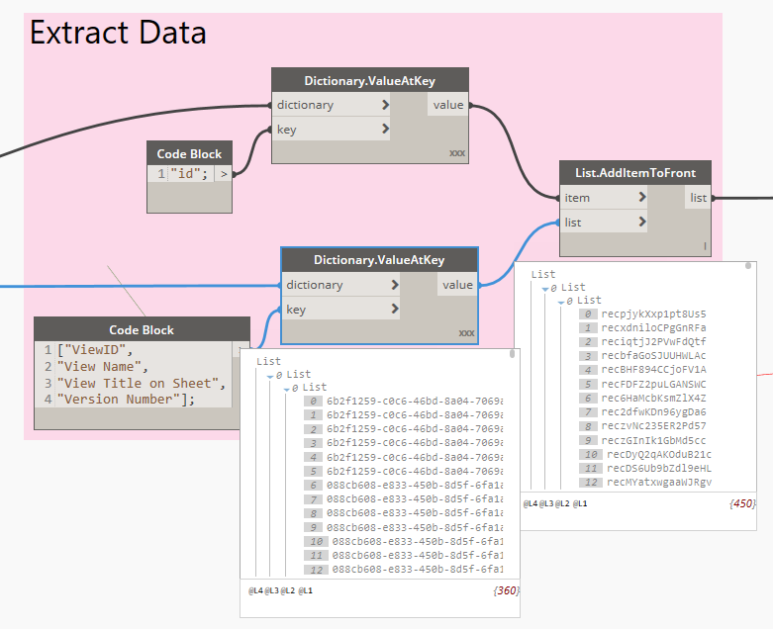
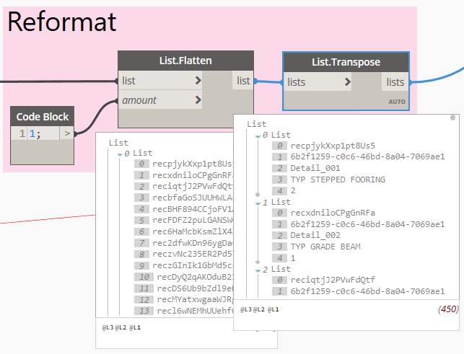
Download Data from Airtable
Parse data
Extract Data
Reformat

Slide 29
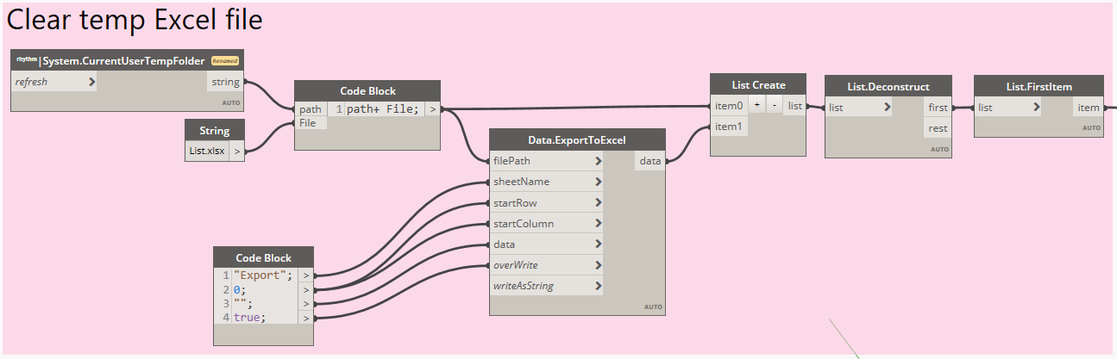
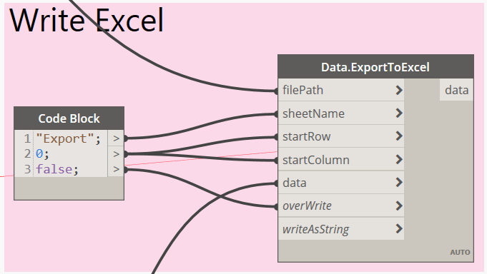
Download Data from Airtable
Clear temp file
Write data to excel

Slide 30
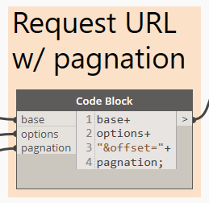
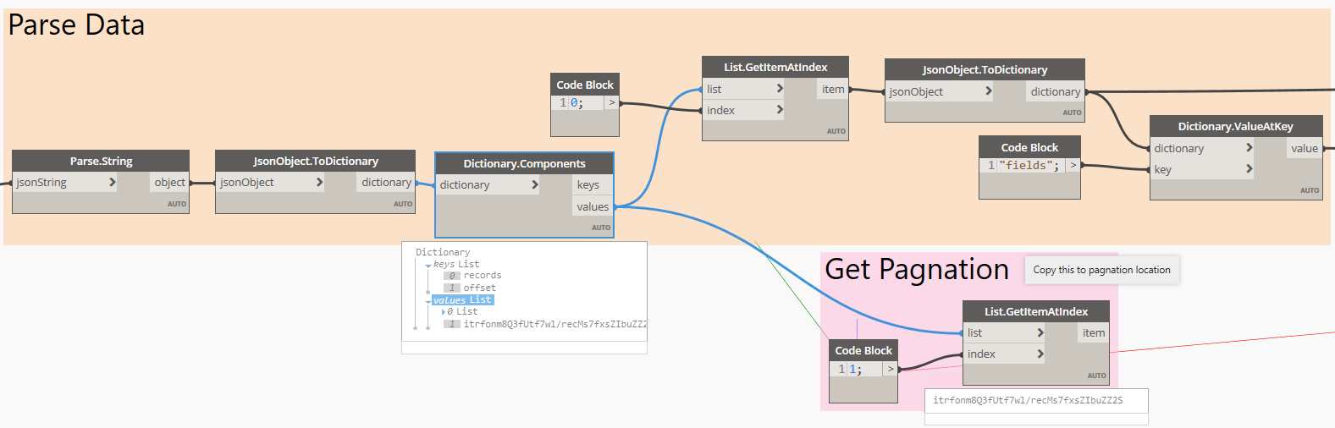
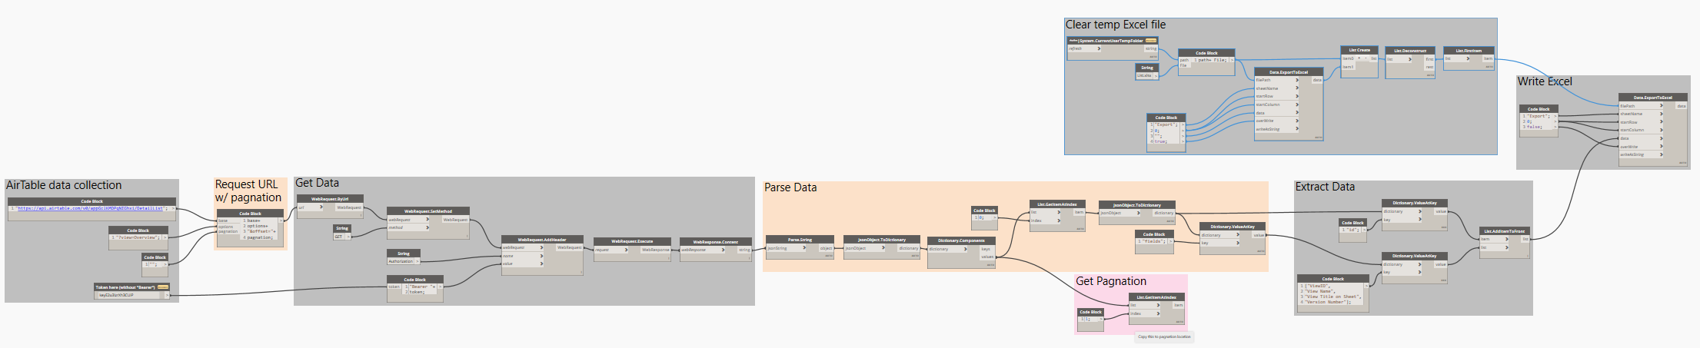
Dealing with Pagination
Adding to header
Extract pagination value
Remainder is the same

Slide 31
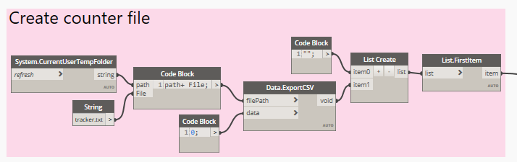
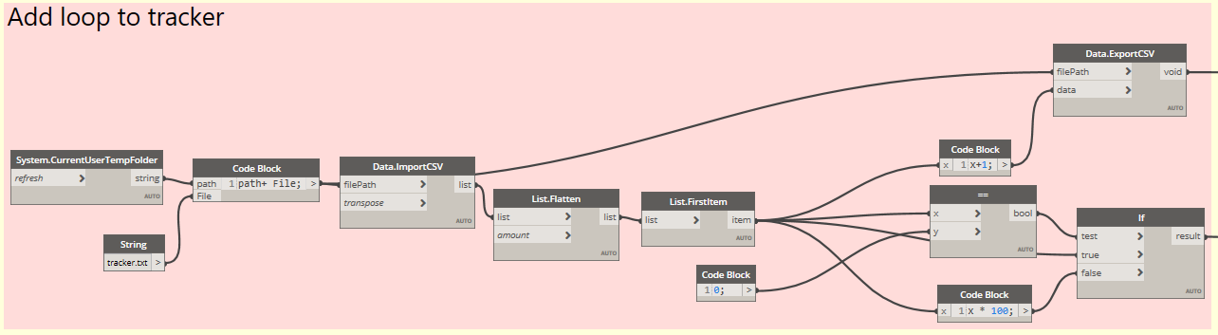



Looping
Creating a counter file
Updating counter file / loop
Loop until no pagination

Slide 32


Importing Data
Import data
Remainder script same

Slide 33




Updating Views
Get all views with AirTable ID
Get Airtable ID Get Version Number Match ID Align Version
Update parameter

Slide 34




Checking a View in a Project File
Prep the local Excel file
Filter to drafting views with AirTable ID
First only for this run
Extract data from view

Slide 35



Checking a View in a Project File
Build the header
Execute the request & parse response
Extract Data

Slide 36



Checking a View in a Project File
See if version number match Data
Report Result of check
Create report

Slide 37





Checking all Views in a Project File
Create Loop based on count of views
Loop within node same as previous examples
No other changes

Slide 38
Conclusion

Slide 39
review
Standards are important but they change…lets make it easy
How do I make sure designers are using the current details?
Revit
Dynamo
REST API
Airtable

Slide 40





Just the start
We started with the basics
Can layer on more sophisticated moderation and approval checks
Documentation
Change Requests
Approval Process

Slide 41


Your homework
All our base are belong to you!
GitHub Repo

Slide 42
Thank you
ThorntonTomasetti.com

